Slide 1
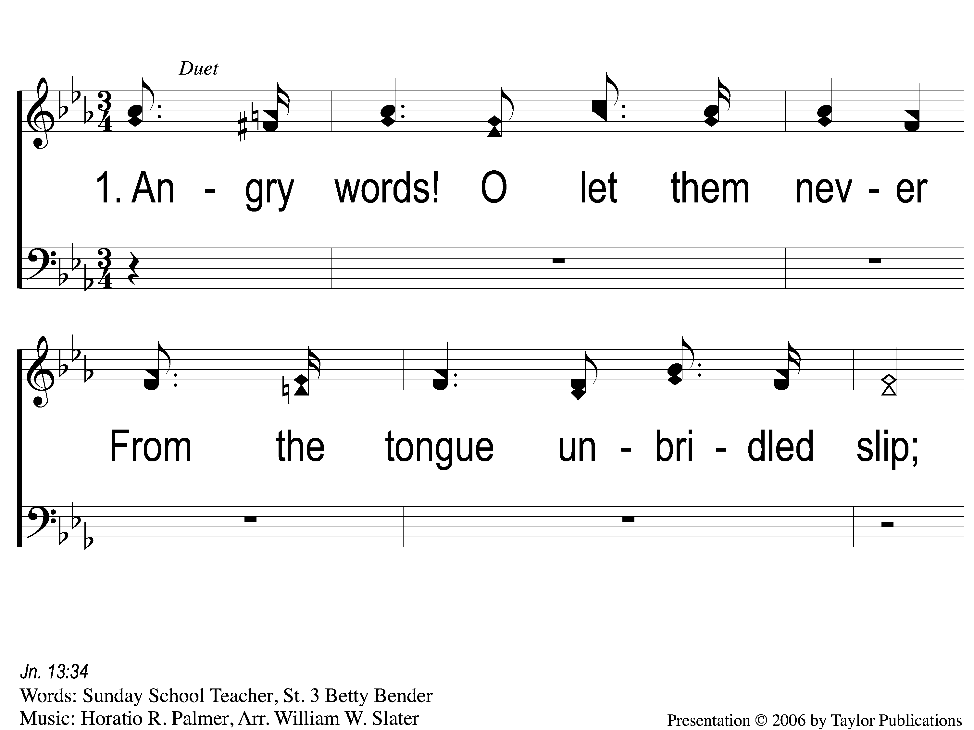
1-1 Angry Words
Angry Words
23

Slide 2
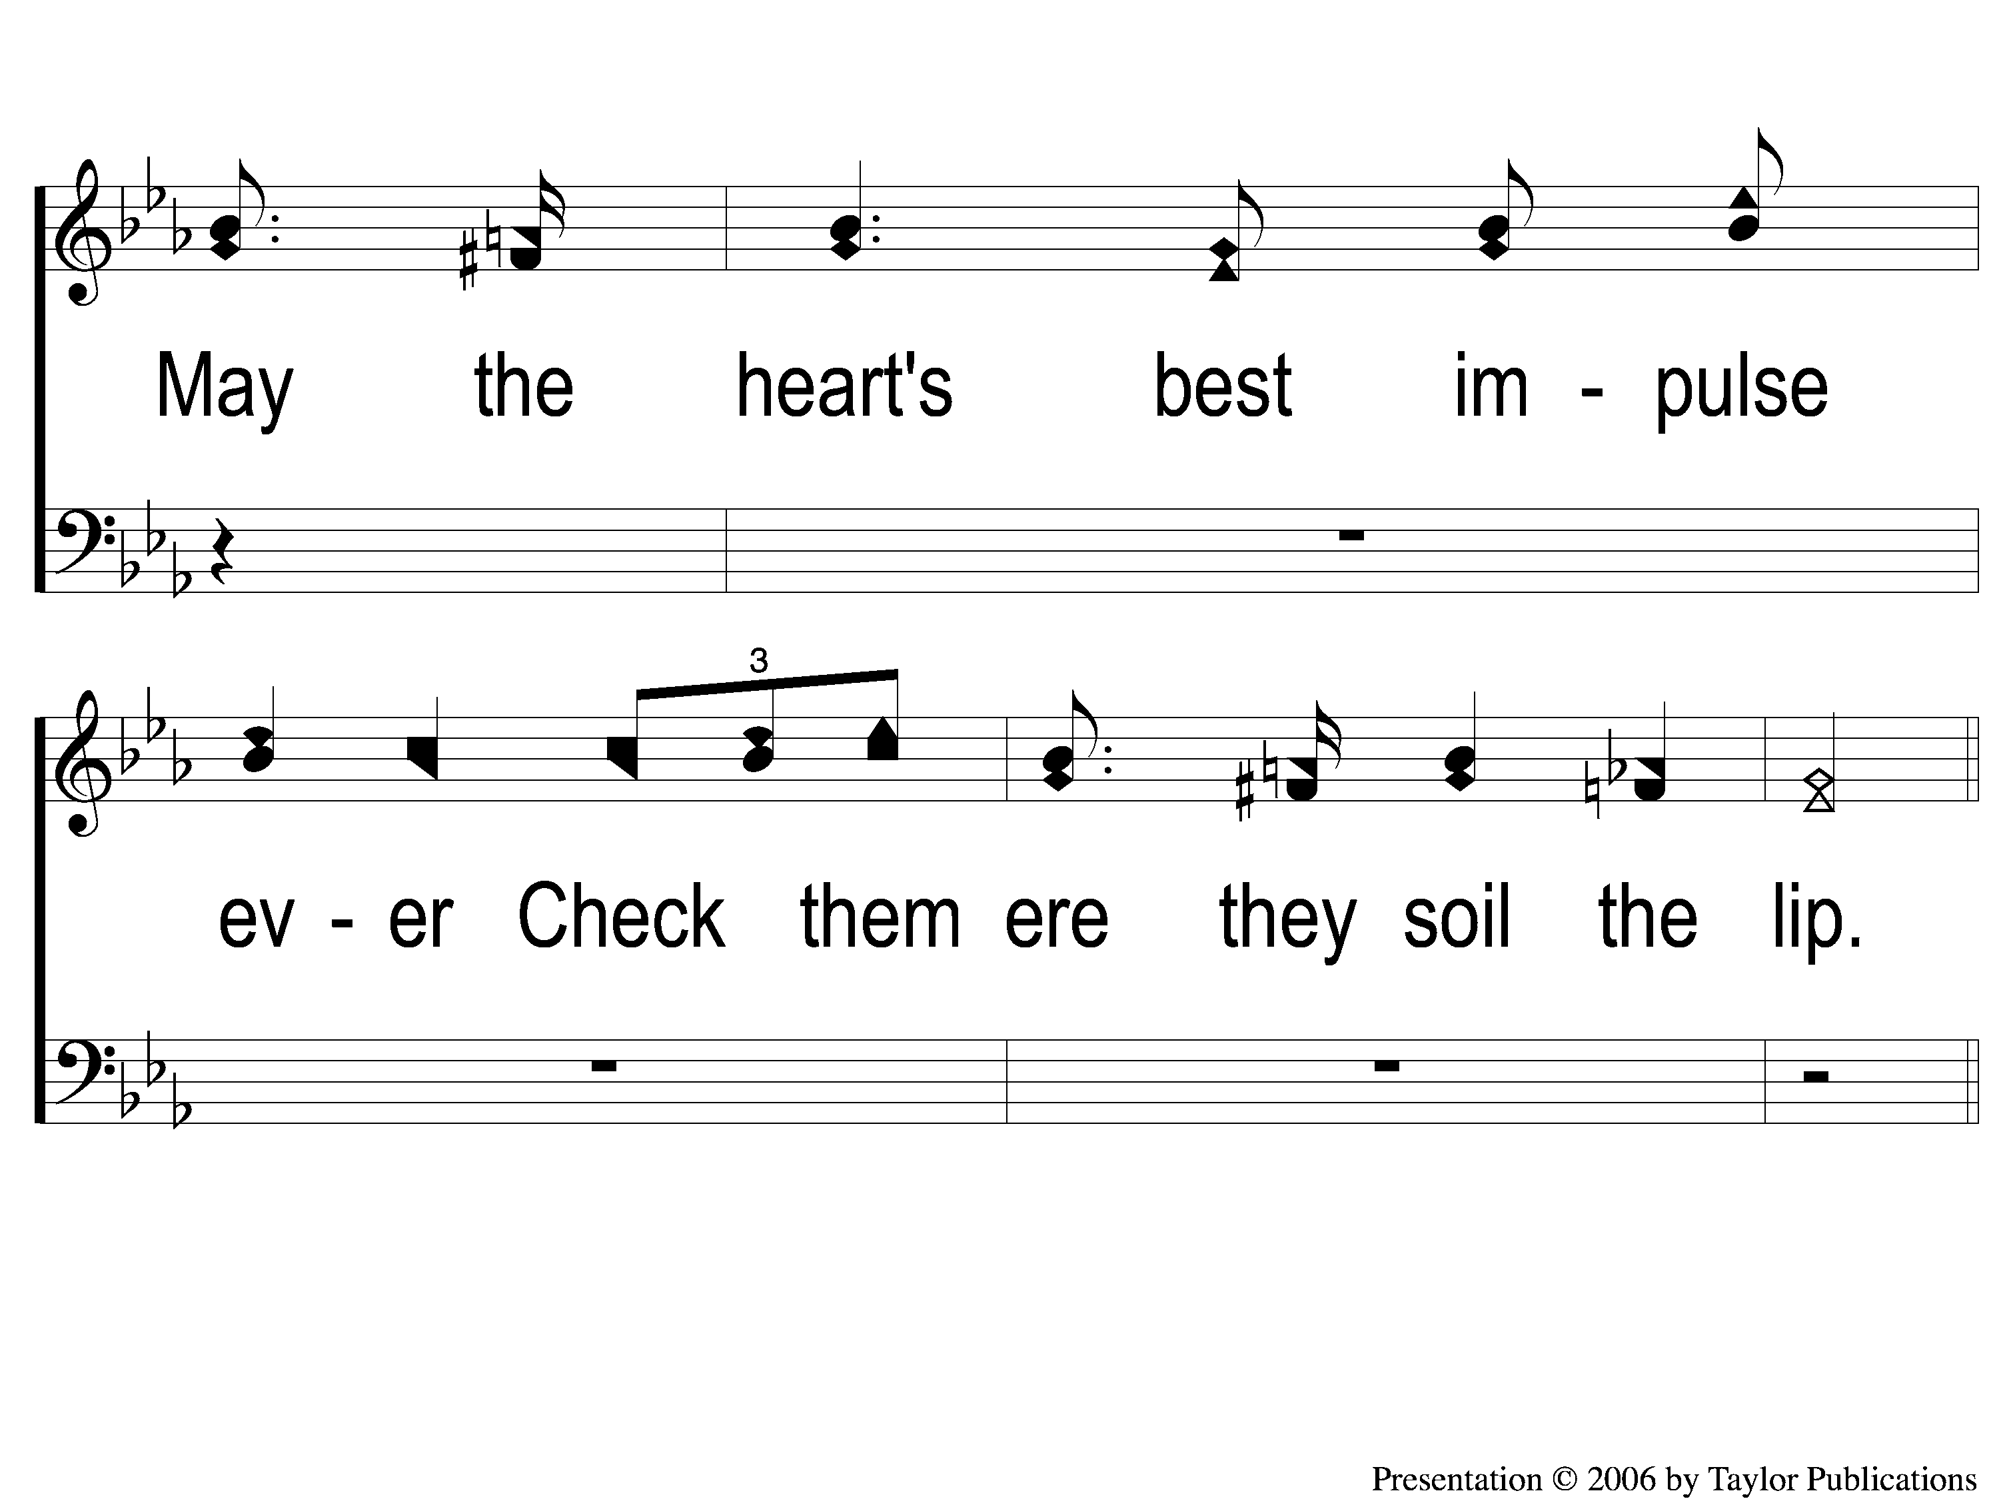
1-2 Angry Words
Angry Words
23

Slide 3
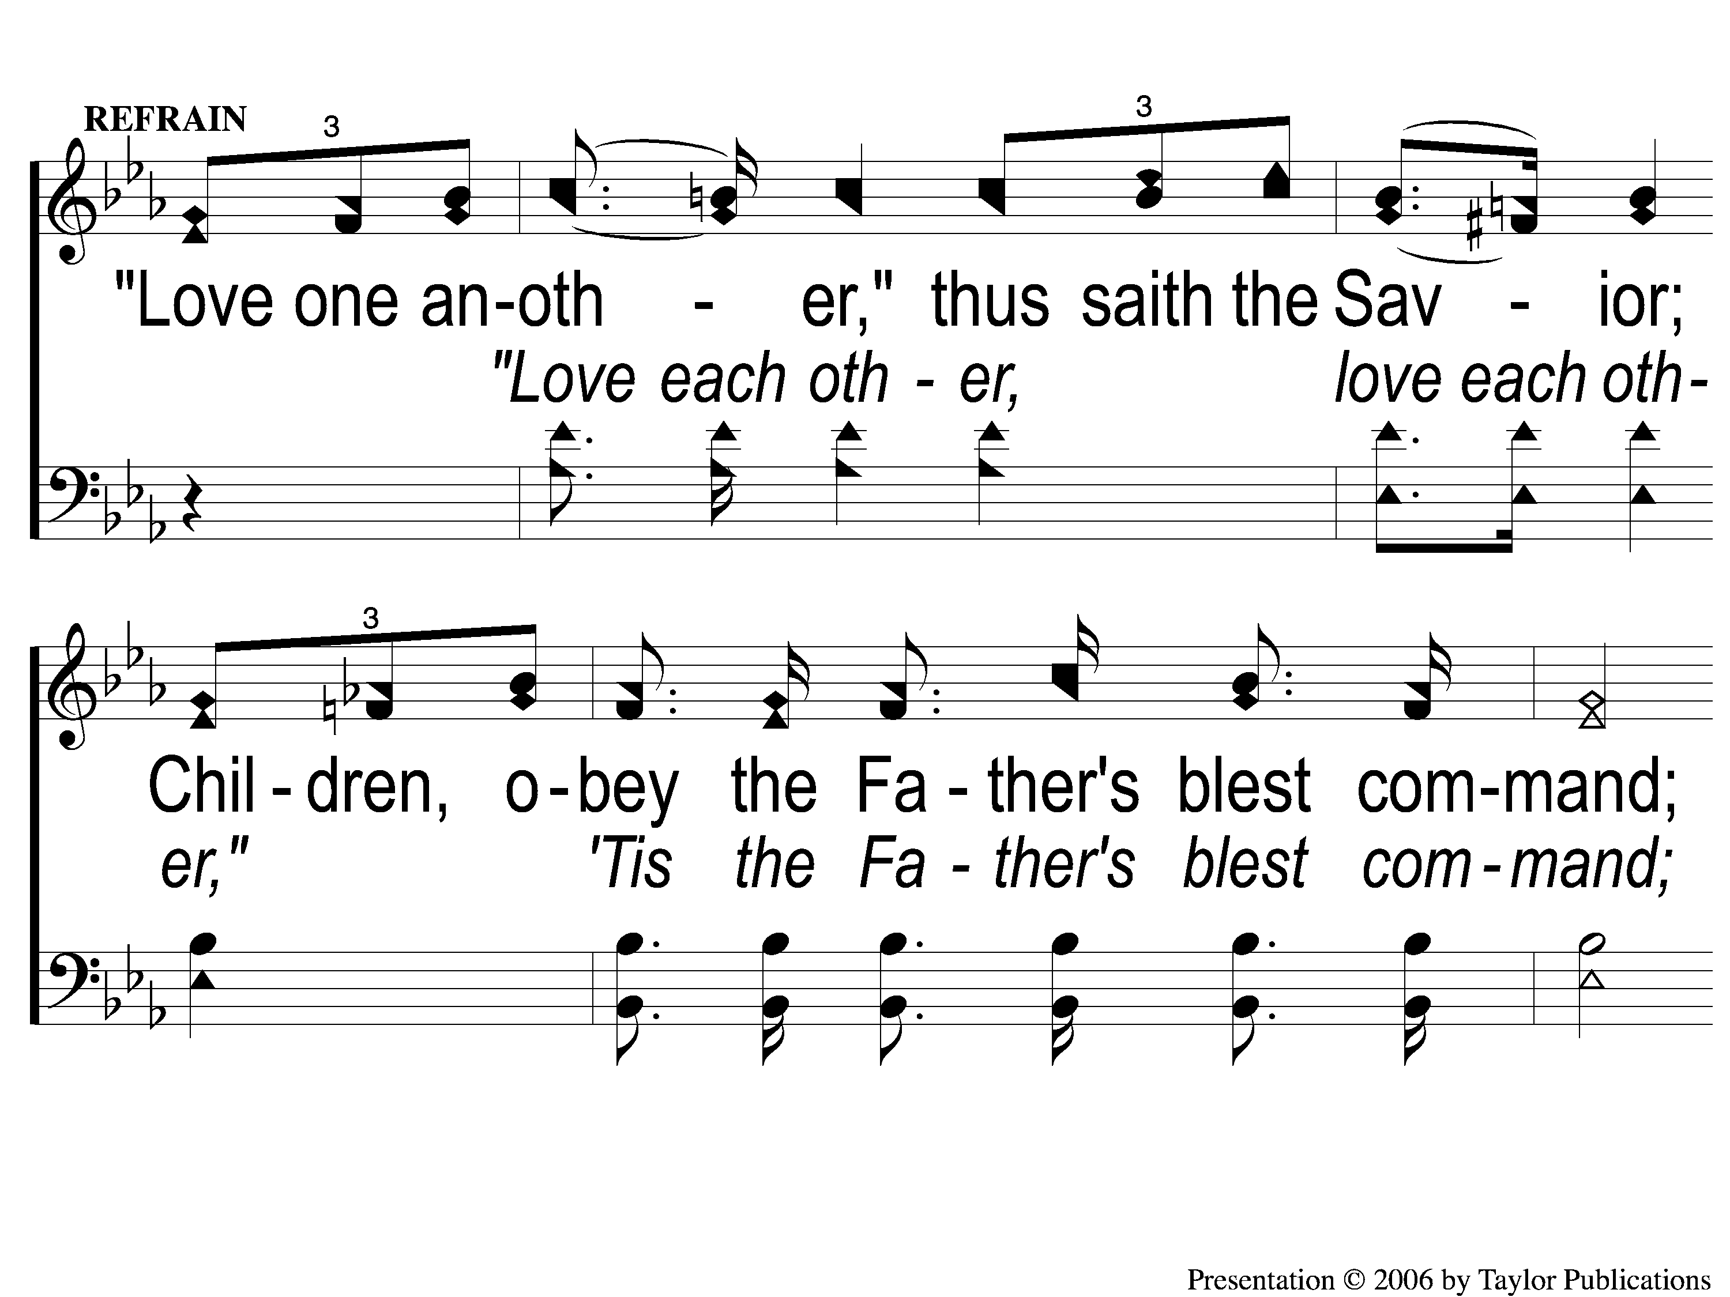
C-1 Angry Words
Angry Words
23

Slide 4
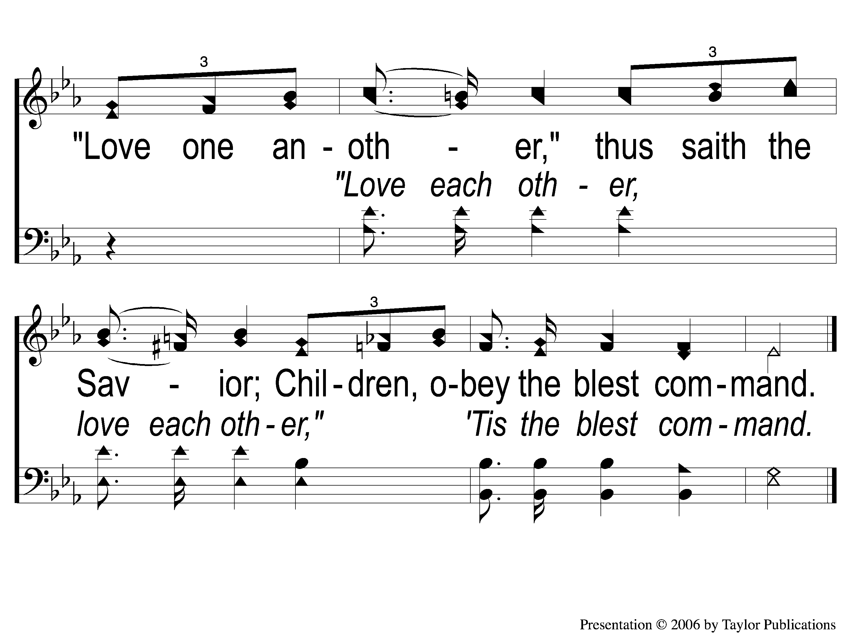
C-2 Angry Words
Angry Words
23

Slide 5
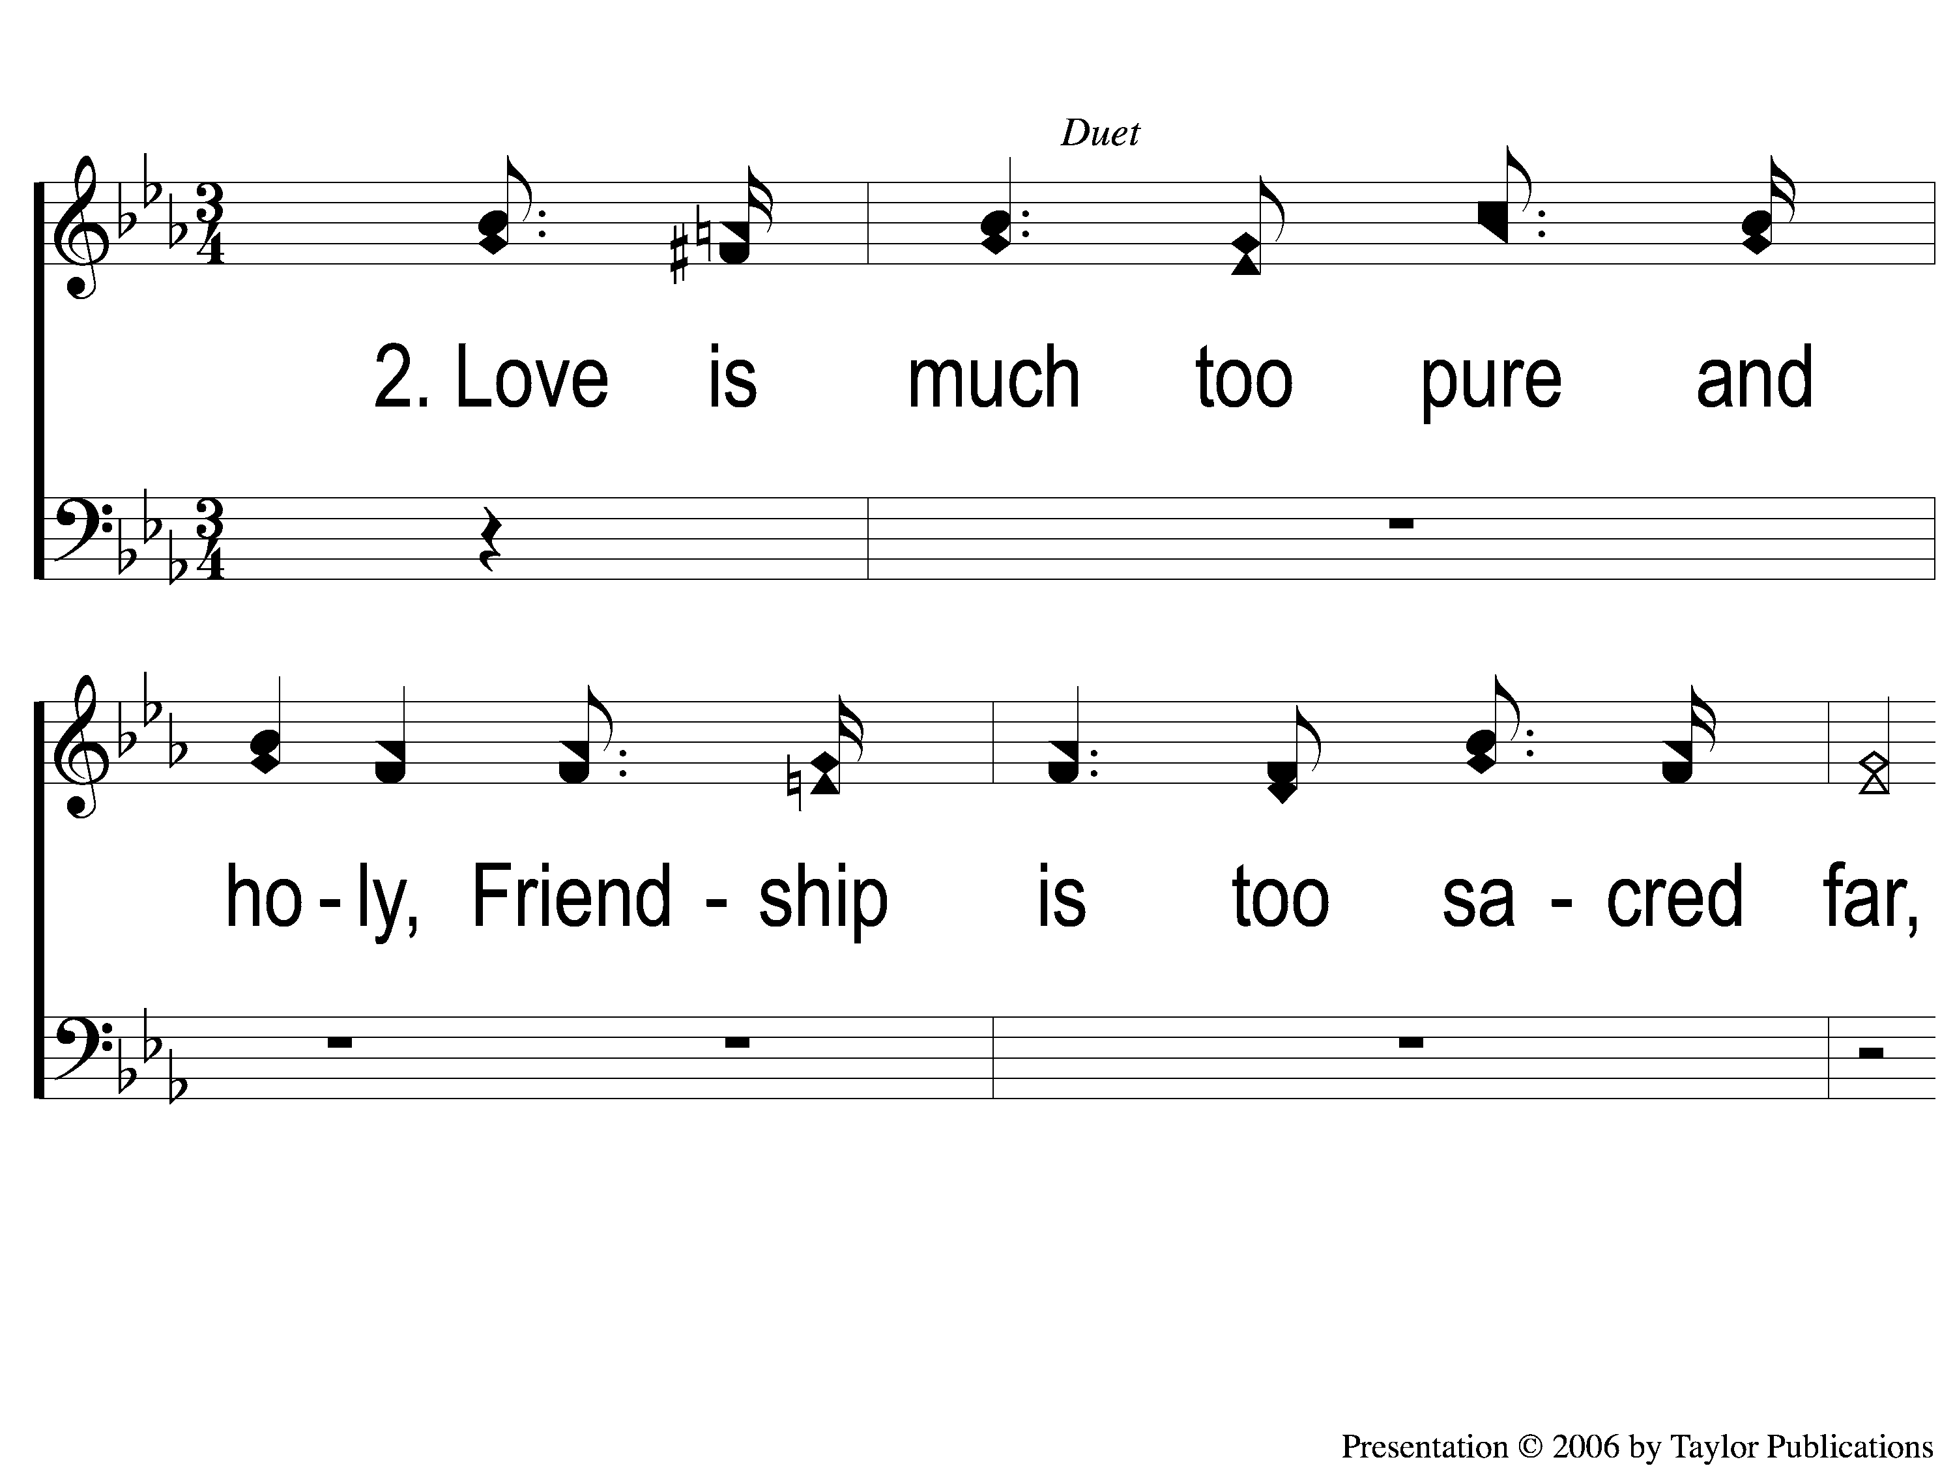
2-1 Angry Words
Angry Words
23

Slide 6
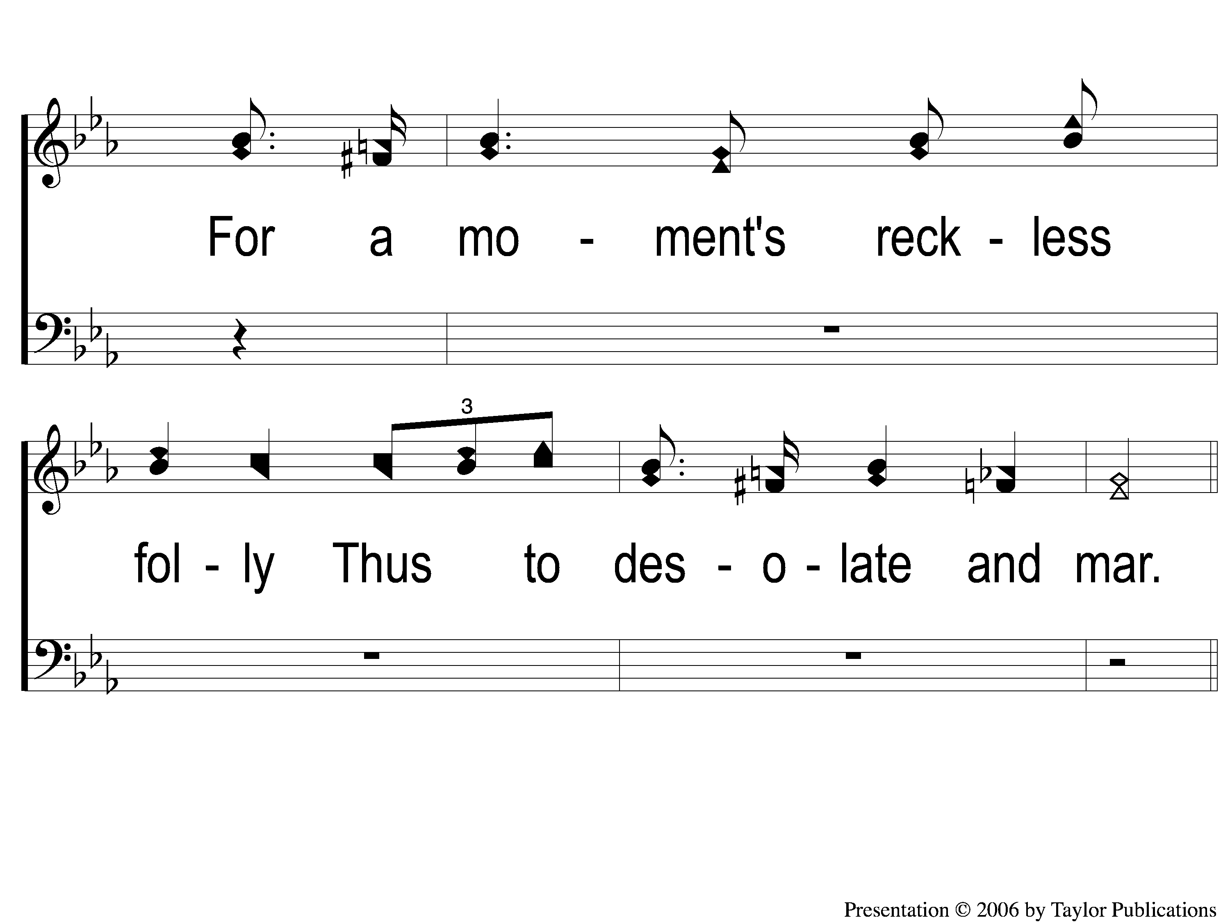
2-2 Angry Words
Angry Words
23

Slide 7
C-1 Angry Words
Angry Words
23

Slide 8
C-2 Angry Words
Angry Words
23

Slide 9
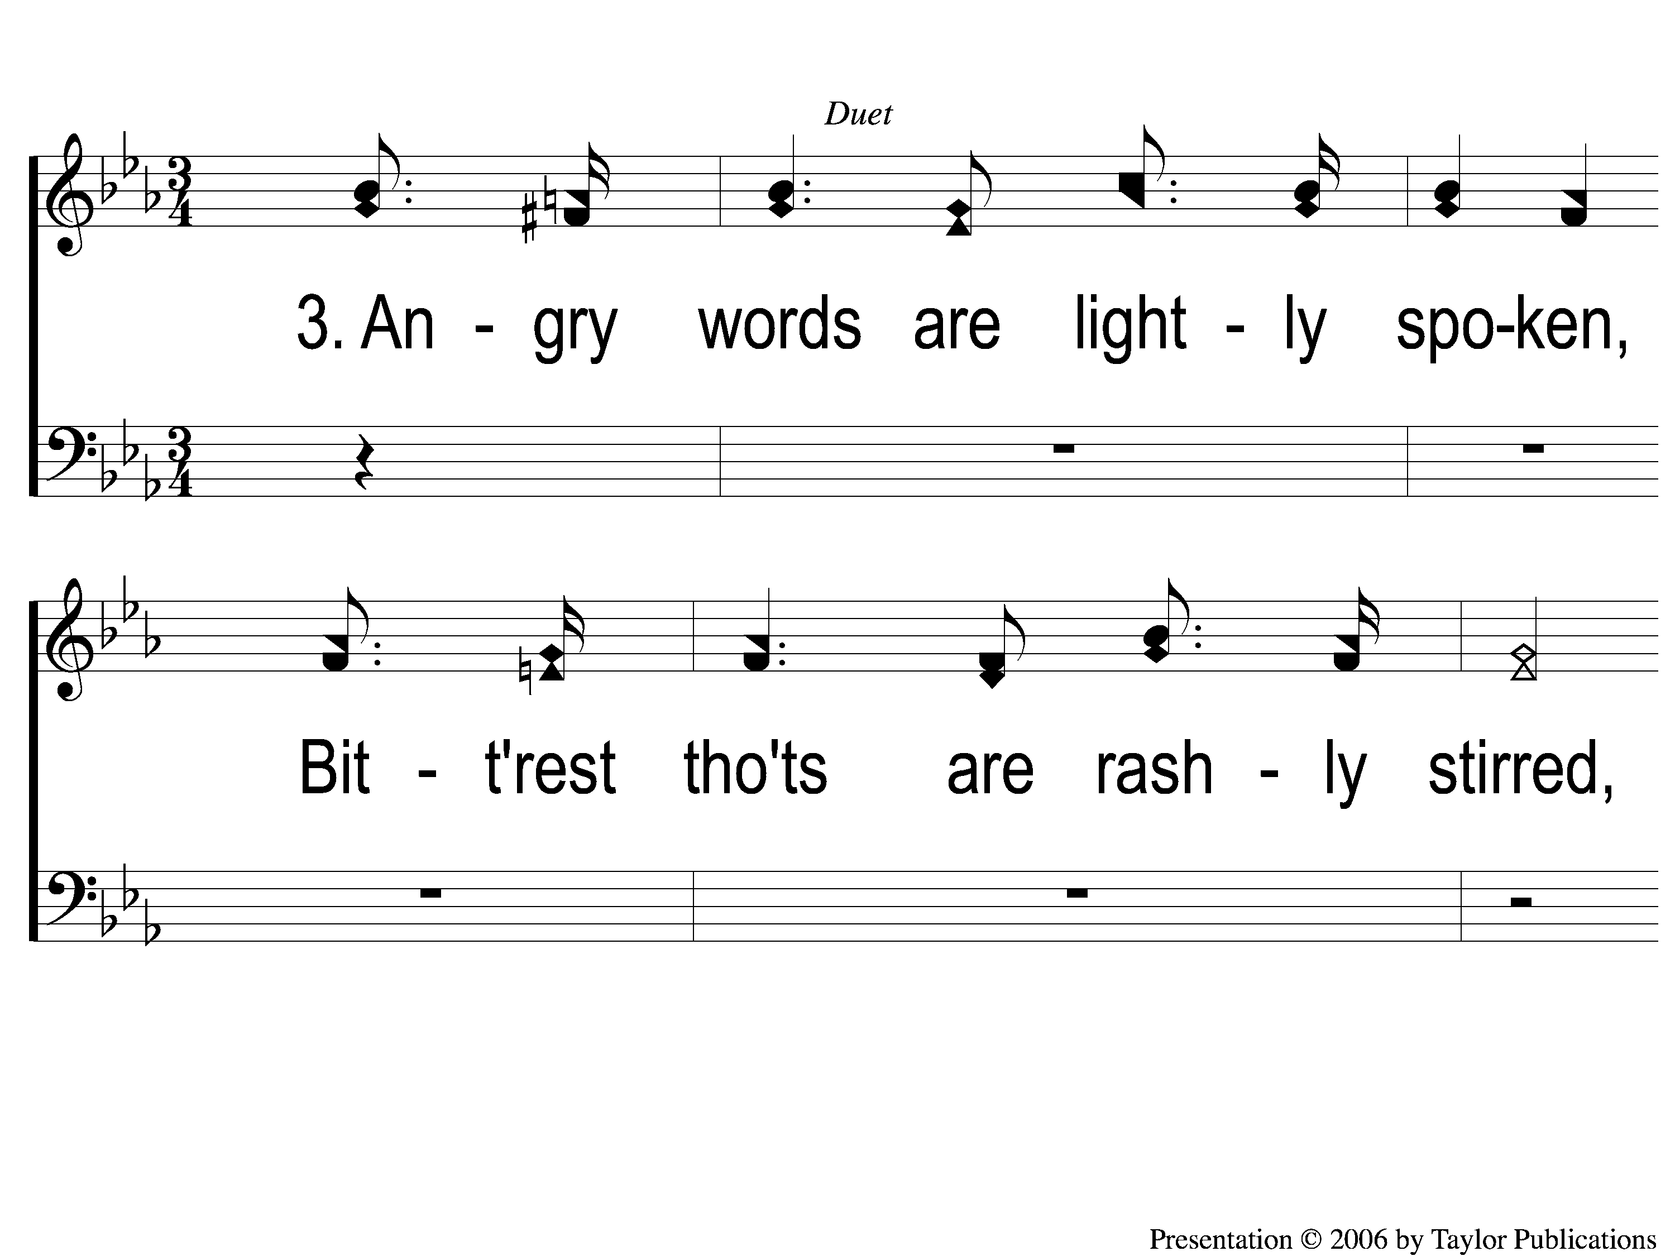
3-1 Angry Words
Angry Words
23

Slide 10
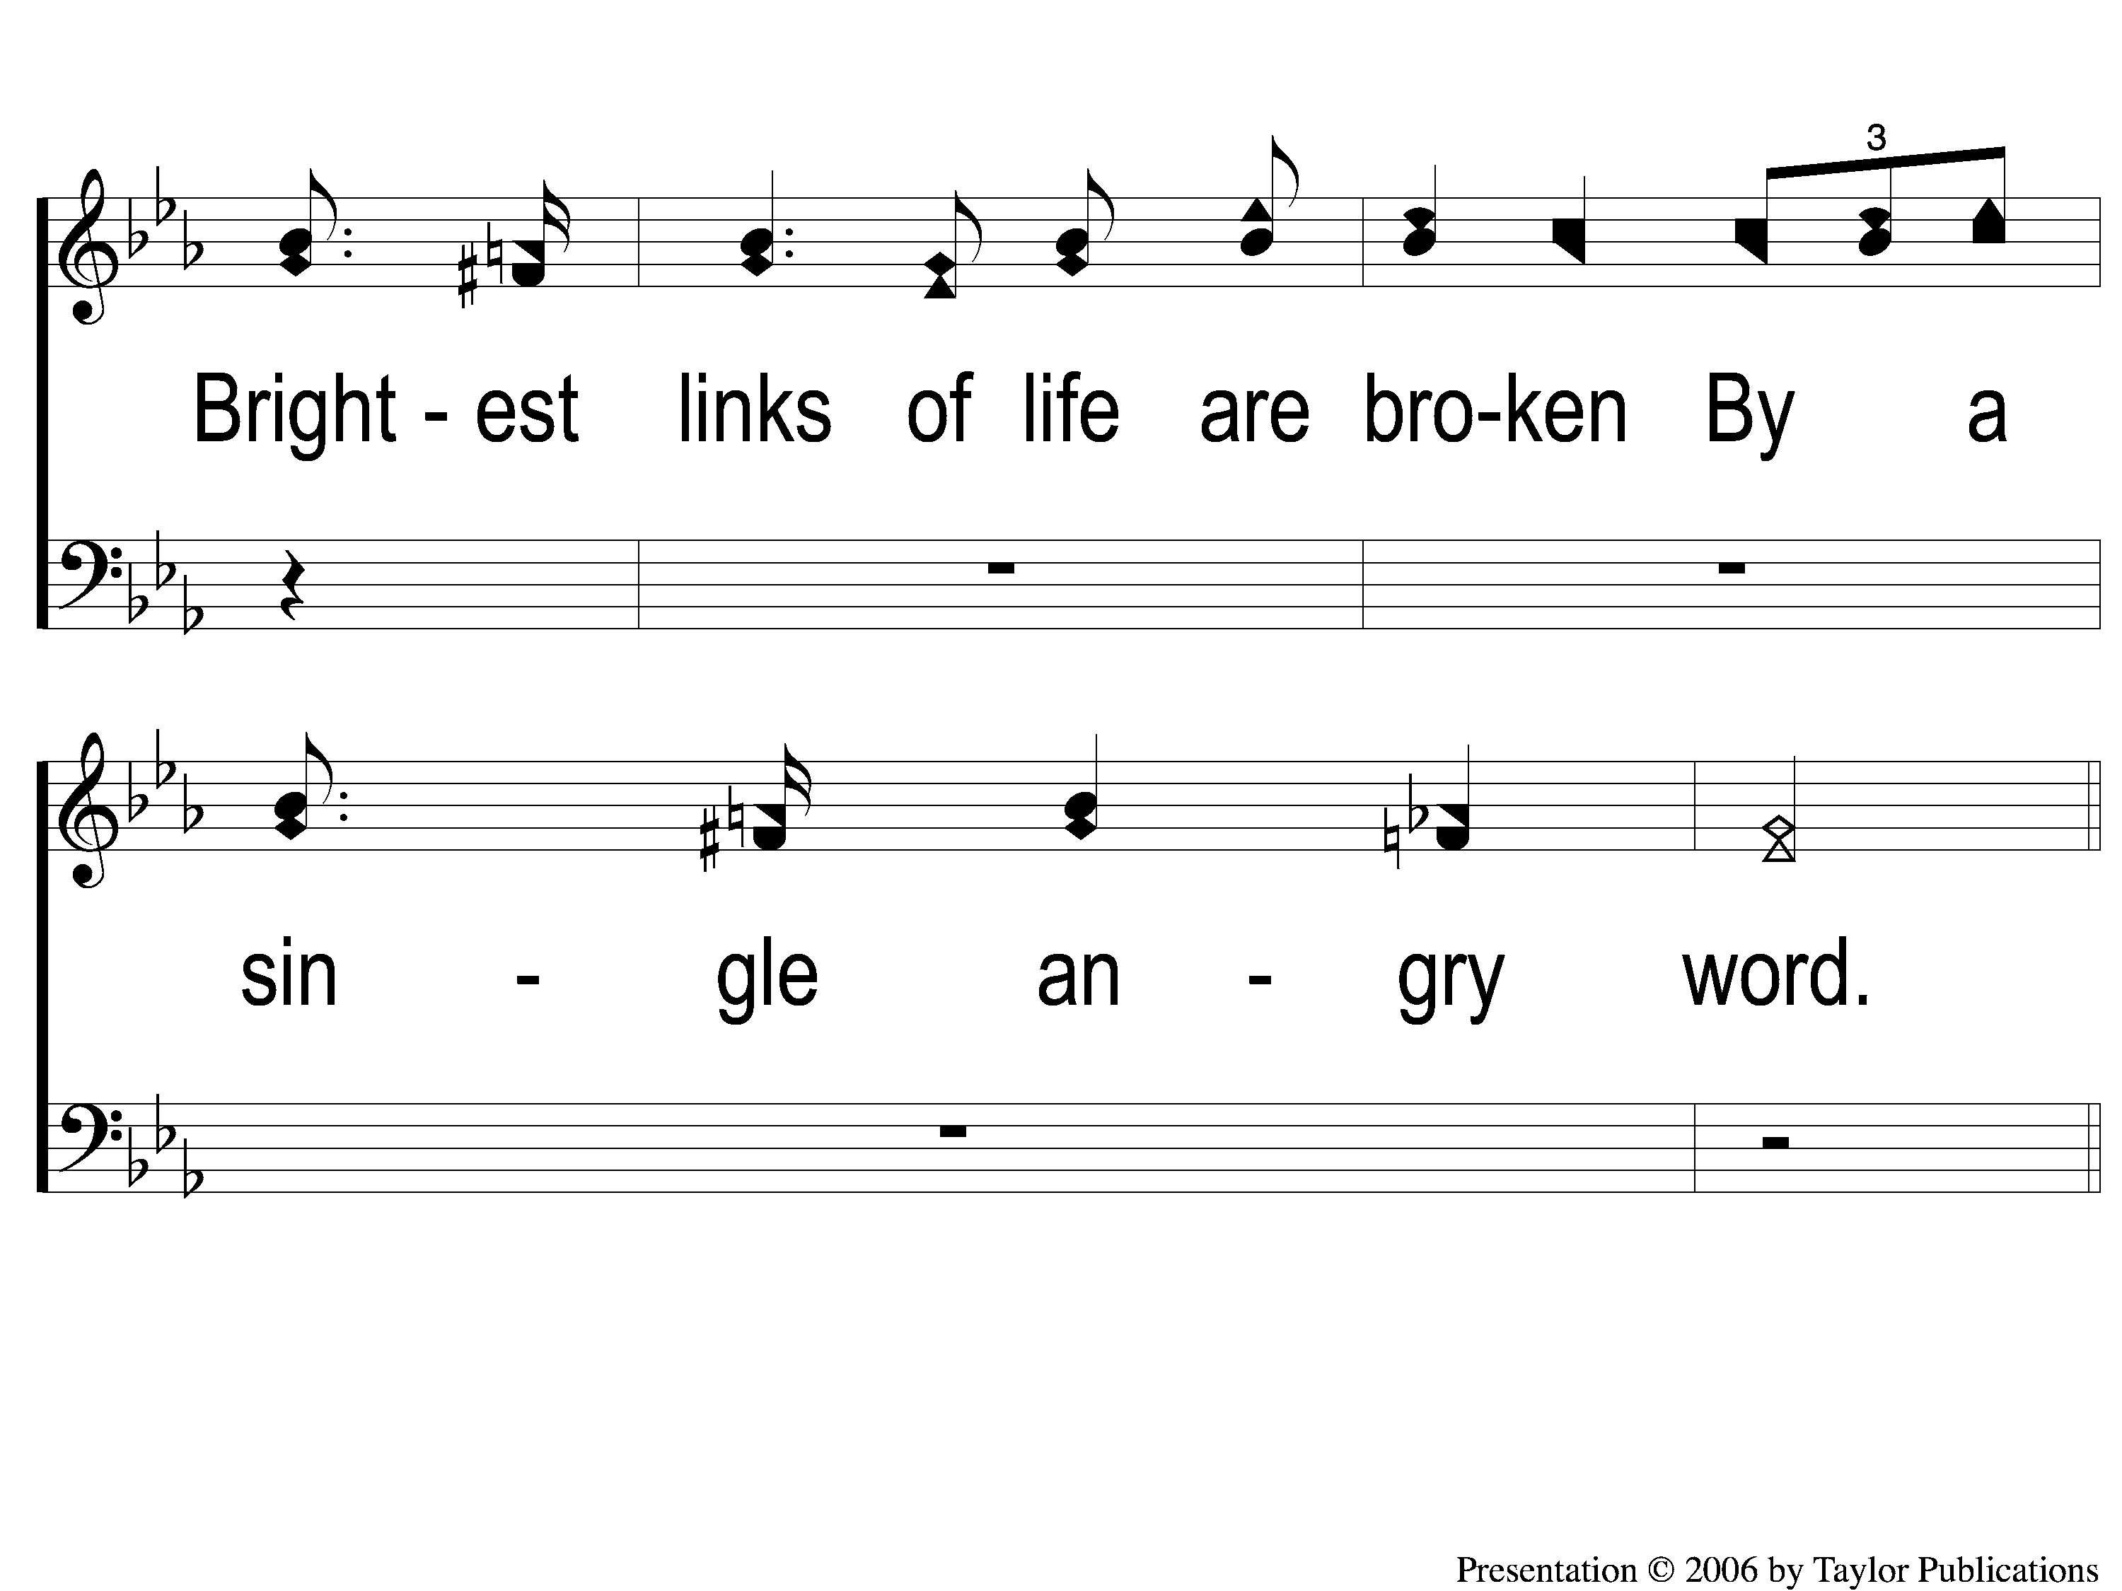
3-2 Angry Words
Angry Words
23

Slide 11
C-1 Angry Words
Angry Words
23

Slide 12
C-2 Angry Words
Angry Words
23

